Slide 1
Gaston County Schools Volunteer Orientation
2021-2022
School Year

Slide 2
Gaston County Schools District Policy Code: 5010 for Volunteers
Requires
Adequate screening & supervision of volunteers based upon the amount of contact they will have with students.
Adequate training of volunteers, including familiarizing volunteers with applicable laws, board policies, administrative procedures and school rules.

Slide 3
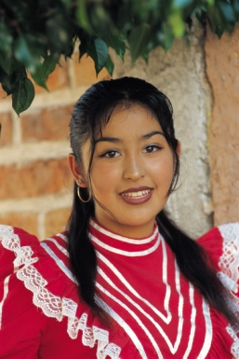
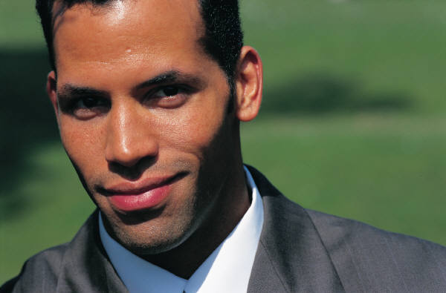
Gaston County Schools welcomes
parents and patrons to volunteer and become involved in supporting students, teachers and public education.

Slide 4
Make sure you have submitted your volunteer application on line
www.gastonschoolvolunteers.com
OR
Go to the Gaston County Schools Website and click on the “Volunteers” Icon -
Bottom of page (third from right )

Slide 5
A view of the one page application

Slide 6
Please note:
The following five slides cover
the 10 Item
“Code of Conduct” for Volunteers

Slide 7
Volunteer Code of Conduct
Items 1-10
#1. Upon arrival, I will sign in at the main office using the designated computer system. Use license or photo ID when checking in.
#2. The computer will create a volunteer/visitor identification badge which I will wear while on school grounds.
#3. I will MAINTAIN CONFIDENTIALITY outside of school and share with teachers and /or administrators any concerns that I have related to student welfare, safety or volunteer activity.

Slide 8
Code of Conduct continued
#4. I will not disclose, use or disseminate student photographs or personal information about students.
#5. I agree not to exchange telephone numbers, home addresses, e-mail addresses or any other home directory information with students. I agree not to contact students outside of school hours.

Slide 9
Code of Conduct continued
#6. As a volunteer, I understand that I should not be alone at any time with any student(s) and always under the sight, sound and supervision of a Gaston County School staff employee.

Slide 10
Code of Conduct continued
#7. While volunteering at school, I will use specified (adult) restroom facilities. When chaperoning field trips, volunteers should work in pairs to escort students to rest room facilities.
#8. I will follow teacher and staff instructions during fire and emergency drills, as well as lock down procedures for the purpose of school safety.

Slide 11
Code of Conduct continued
#9. I agree to do what is in the best personal and educational interests of every child with whom you come in contact.
#10. I agree to maintain professionalism and demonstrate respect for school policies and dress appropriately while on school grounds.

Slide 12
Code of Conduct for Volunteers
By initialing the Code of Conduct Items #1 through #10 on the online application, you acknowledge that you will accept and abide by the procedures and protocol for volunteers and also understand
a background check is
performed when the
application is submitted.

Slide 13
Caution about Social Network Sites
Be aware of the content of your personal postings on Social Networking Sites. Adjust settings to ensure your privacy and protection.
Be aware of specific elements of
Code of Conduct #5 that apply
to posting photographs. As a volunteer, you do not have parental permission to post
pictures containing children that
are not your own.

Slide 14
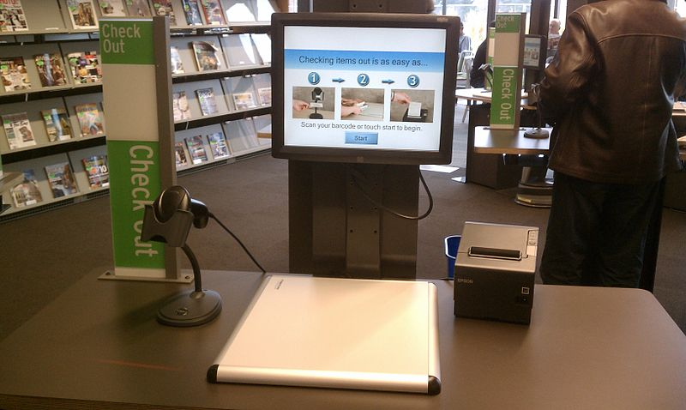
Always Check In and Out In The Office
Check in on arrival:
Scan Driver’s License or other acceptable ID
to check in each time you come to volunteer
Insert ID Photo face up to scan.
Check out when leaving:
Scan bar code of your printed visitor badge to check out when leaving building.

Slide 15
ID Badges
ID badges printed from the Visitor Management System will contain your photograph on the left along with the date of visit.
Remove backing and place sticker to clothing so it is visible.
Id badge will have a bar code on the right which you will scan to check out when leaving the school.

Slide 16
A Word About Sexual Harassment
Sexual Harassment as defined in
Gaston County Schools
Policy Code 4360/7240
“Unwelcome sexual advances, requests for sexual favors and other verbal or physical conduct of a sexual nature.”

Slide 17
Sexual Harassment Related to Students Occurs When
There is unreasonable interference with a student’s educational performance.
It limits a student’s ability to benefit from an educational program or environment.
It creates an Abusive, Intimidating, or Hostile Offensive Educational Environment.

Slide 18
Examples of Sexually Harassing Conduct
Continued or repeated offensive sexual flirtations, advances, jokes, humorous comments, or propositions or repeated verbal remarks.
Deliberate unwelcome touching of a sexual nature.
Suggestions or demands for sexual involvement accompanied by implied or overt promises of preferential treatment or threats.
Display of sexually suggestive objects or pictures.

Slide 19
Duty to Report Crimes Against Juveniles (General Statute 14-318.6)
All adults, including school employees, contractors, and volunteers are legally required to report:
When they know or reasonably should know that a child has been the victim of certain crimes, including “sexual offense” (which means any offense that relates to inappropriate sexual contact with a child).
Any person who knowingly and willfully fails to report, OR prevents another person from reporting, is guilty of a Class 1 misdemeanor
This obligation to report is in addition to any other reporting obligation under other law.
Those reporters, made in good faith, are immune from state, civil or criminal liability.

Slide 20
Reporting Sexual Harassment
Sexual Harassment by employees, students and non employees including volunteers and visitors, should be reported to a school official (principal/administrator).
The school district has a Title IX coordinator that may also receive reports or concerns.
website : www.gaston.k12.nc.us/Page/8992

Slide 21
Remember…Volunteers Do:
Work positively for the good of the school.
Praise and encourage students.
Keep student work and information confidential.
Show consideration of the teacher’s time.

Slide 22
Volunteers Don’t….
Make comments harmful to the reputation of any pupil, professional or other volunteer.
Get physical with a child.
Violate confidentiality by passing on information to the community.

Slide 23
Frequently Asked Questions ?????
Do I have to submit a new application each year?
No, once you submit an on line application you do not need to resubmit. You will “REACTIVATE” your application at the beginning of a new school year by logging in with your login and password, review and update any information (add or delete schools) and click submit.
Do I need to attend an Orientation every year?
No, the date you attended orientation is put on your application for the future. No additional session is needed.

Slide 24
More FAQ ?????
Now that I have completed orientation when can I begin volunteering?
Volunteer assignments are made at the school level. Contact the school(s) where you plan to serve to discuss your volunteer schedule.
I chose more than one school to volunteer at but only received an email from one saying I am approved. Will I be able to volunteer at the other schools?
Each school principal accepts and reviews applications for their school. This is done at different times depending on the principals schedule. If you are notified of approval at one school, additional school notification should follow .

Slide 25
Volunteers are an important resource to our school district.
Your conscientious gift of time can make a difference for students, teachers and our school system.
Volunteerism is an honorable and cherished contribution to our society.

Slide 26
Directions to complete online orientation:
Email: businesspartnerships@gaston.k12.nc.us
Include:
1. Your NAME as it appears on your application
2. The date you reviewed the power point
3.Include the following statement :
“I have completed an online orientation and agree to abide by the Code of Conduct for Gaston County Schools as stated in this power point”
4. Add your initials to the statement.
Call 704-866-6329 if you have questions

Slide 27
THANK YOU
FOR YOUR INTEREST AND SUPPORT OF GASTON COUNTY SCHOOLS!!

